Slide 1


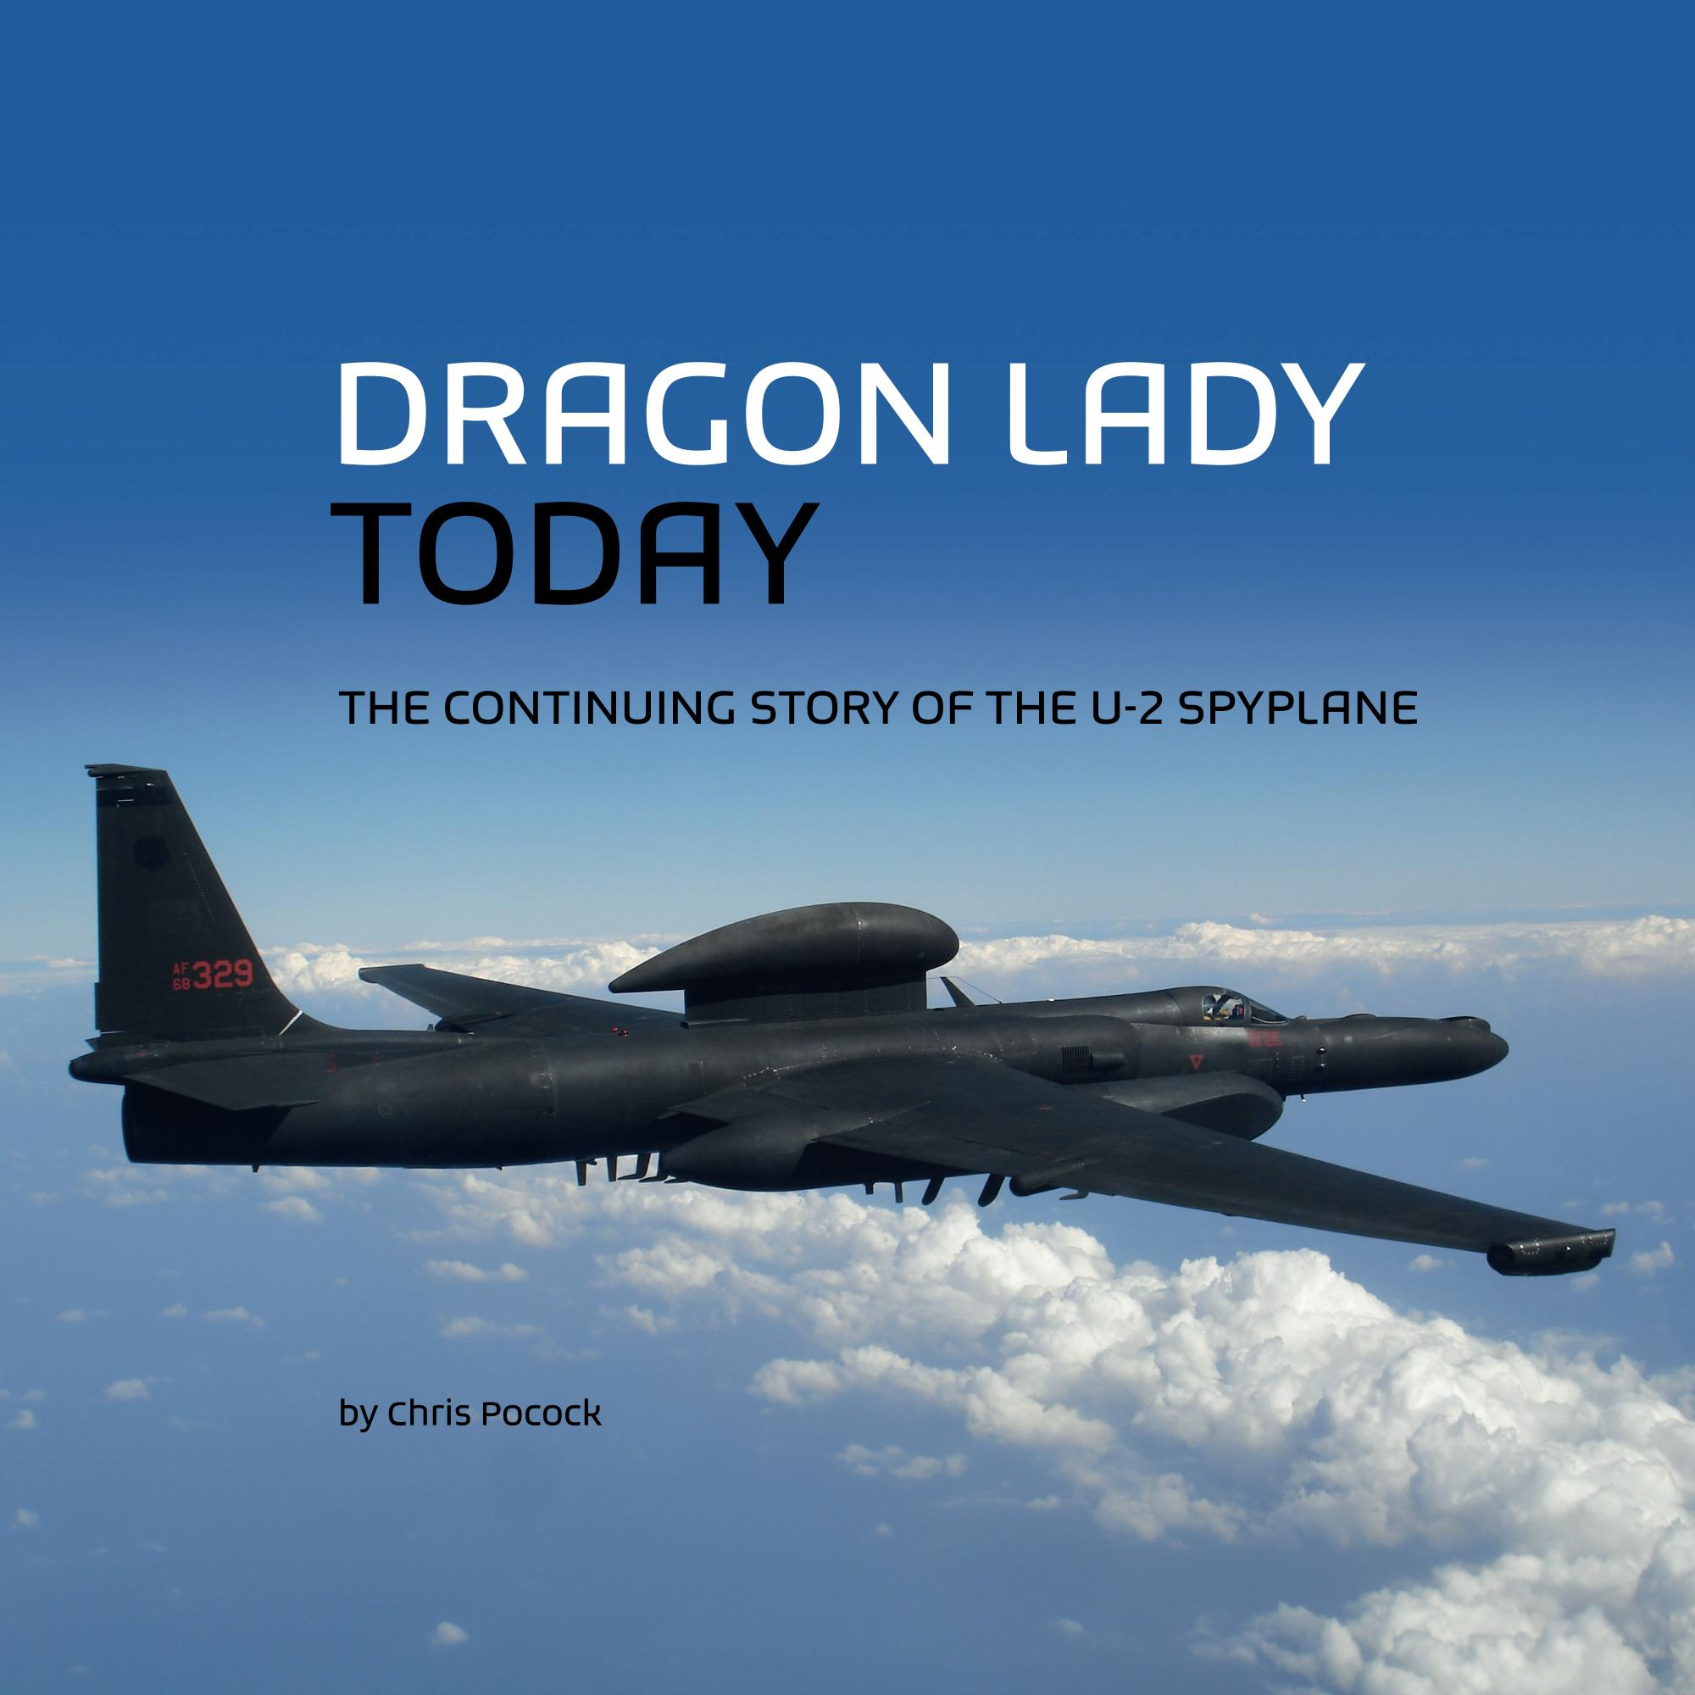



RAeS Hamburg in cooperation with the DGLR, VDI, ZAL & HAW invites you to a lecture
A Brief History of the U-2 Spyplane
Chris Pocock
Aviation Author & Historian
Date: Thursday 16 April 2026, 18:00
Location: HAW Hamburg, Berliner Tor 5, Hörsaal 01.10 (in-person only!)
The Lockheed U-2 is a strategic reconnaissance aircraft, which played a crucial role during the tense years of the Cold War. It came to fame when pilot Francis Gary Powers was shot down over the Soviet Union in 1960. However the aircraft has been frequently updated, is still operated by the United States, and over more than 70 years it has seen action in most conflicts around the world, providing vital intelligence information to the US and its allies. Built by the famous Lockheed ‘Skunk Works" under the direction of Clarence L. "Kelly" Johnson, the U-2 was, and is, truly the most successful intelligence-gathering aircraft ever produced.
© Chris Pocock
Chris Pocock is a British full-time writer, specialising in aerospace. He was the defence editor of AVIATION INTERNATIONAL NEWS until retiring in mid-2018. He continues to write articles and commentaries on aerospace/defense issues.
His interest in the U-2 started in the early 1970s with a visit to Davis-Monthan AFB, which was then the home of the US Air Force U-2 wing. In 1989, his first book on the Dragon Lady was published to favorable reviews, including from members of the US airborne reconnaissance community.
So he continued to research the history, and follow the current operations, of this remarkable aircraft. In 1992, he helped to ensure that an original U-2C model and B-camera were preserved and transferred to the Imperial War Museum, Duxford, UK. In 1997, he became the first foreign civilian to fly in the U-2. His largest book, 50 YEARS OF THE U-2, was published in 2005 to mark the aircraft's golden anniversary. He continued the story by publishing DRAGON LADY TODAY in 2015. This book was updated in a second edition in 2024. In 2025, he published SHADOW FLYER, a biography of Bob Ericson, one of the early and most notable U-2 pilots.
© ChatGPT
DGLR / HAW Prof. Dr.-Ing. Dieter Scholz Tel.: 040 42875 8825 info@ProfScholz.de
RAeS Richard Sanderson Tel.: 04167 92012 events@raes-hamburg.de
DGLR Bezirksgruppe Hamburg https://hamburg.dglr.de
RAeS Hamburg Branch https://www.raes-hamburg.de
VDI, Arbeitskreis L&R Hamburg https://www.vdi.de
ZAL TechCenter https://www.zal.aero
Hamburg Aerospace Lecture Series (AeroLectures): Jointly organized by DGLR, RAeS, ZAL, VDI and HAW Hamburg (aviation seminar).
Information about current events is provided by means of an e-mail distribution list. Current lecture program, archived lecture documents
from past events, entry in e-mail distribution list. All services via http://AeroLectures.de.

